Slide 1
Mixed Crowd Simulation in a Virtual Environment
Under the guidance of Dr. Rahul Kala
Submitted by:
Sahil Agarwal – IIT2014120
Abhshek Deora – IIT2014141
Apoorv Dwivedi– IIT20140142
Vipul Agarwal – IIT2014146
Parshant Singh – IIT2014157

Slide 2
Motivation
To design a system able to simulate a crowd of pedestrians interacting in the given scenario conditions. These simulations are used by experts to create animations in movies. The motivation was to make a simulating system so that crowd simulation can be used to represent everyday situations.

Slide 3
The available softwares are difficult to use and also they are not within the reach of everyone. Right now there are hardly any Open Source softwares which can do crowd simulation. Also we wanted to have a “sub-goal” approach to this problem which can be very useful for intelligent crowd simulation

Slide 4
Objectives
Simulation of scenario based crowds in normal circumstances
Providing a unique model that uses a simple and fast system and supports the concept of sub-goals and goals unlike existing crowd simulations with one single goal for all the crowd members.

Slide 5
Methodological steps
Finite State Machine
For the purpose of defining different behaviours of each agent, we have used a Finite State Machine(FSM).
Path Generation
In this segment, we compute a collision free path for satisfying a goal generated according to the goal selection module using Probabilitic RoadMap Model.

Slide 6
Methodological Steps (Contd.)
Movement
Navigation of the agent on a generated path is handled by this module with the help of Helbing’s Social Force Model (1990).

Slide 7
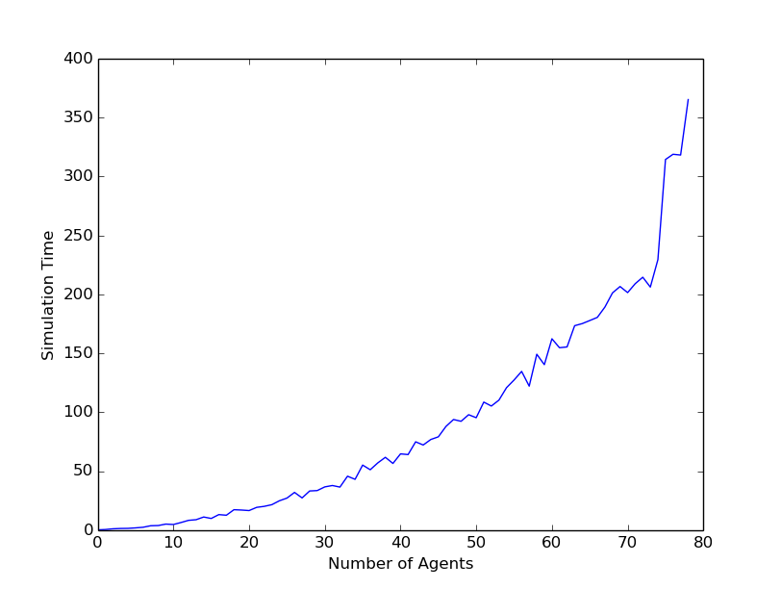
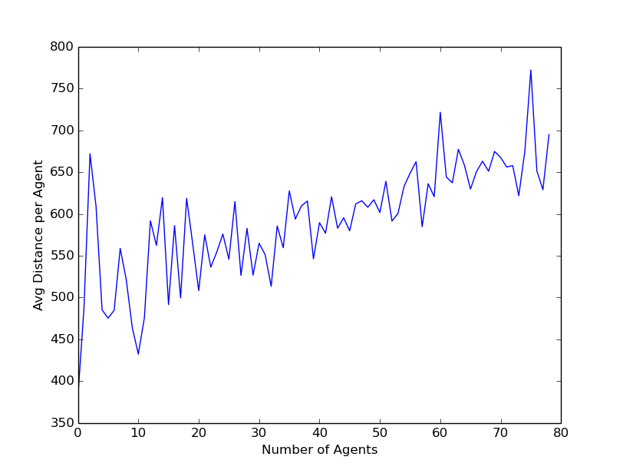
Result of the work done

Slide 8
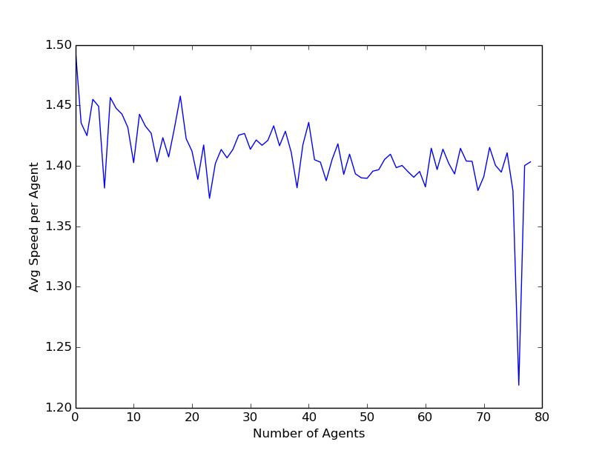
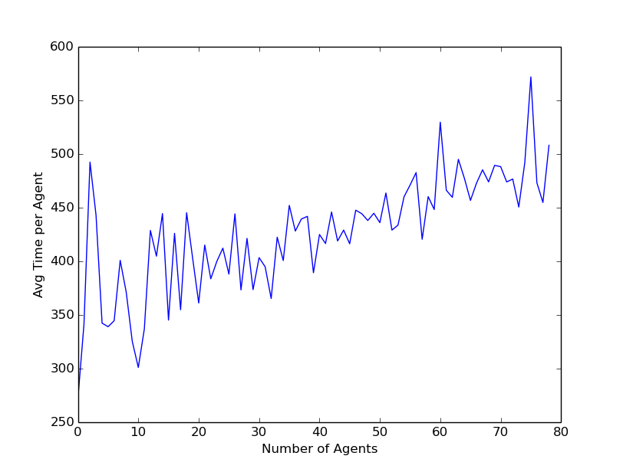
Result (Contd.)

Slide 9
Conclusion
Our simulation was successful in representing different scenarios like Admin office, Railway station, College Campus during fest.
Finite State Machines provide an excellent base for simulating multiple goals.
PRM calculates accurate collision free path in O(n²).
Social Force need O(n) time for each agent resulting in complexity of our simulation to be O(n²).

Slide 10
Future work
The current O(N²) algorithm can be simplified to O(N log N) as research shows that only the nearest four agents are required for force calculations. This will need an extensive implementation of a new data structure which has so far not been used in this project.
The simulation currently works on spherical agents. This can be rectified with properly designed individuals to give this simulation a realistic feel thus requiring a major change in the equations and environment.

